Slide 1
Addressing Mode
CSE-3109 Computer Architecture Lecture 8

Slide 2
Addressing Modes
The CPU can access data in various ways. The data could be in a register, or in memory, or be provided as an immediate value. These various ways of accessing data are called addressing modes.
Register addressing
Immediate addressing
Base addressing or Indirect addressing
PC-relative addressing
PC relative addressing
Pseudo Direct addressing mode

Slide 3
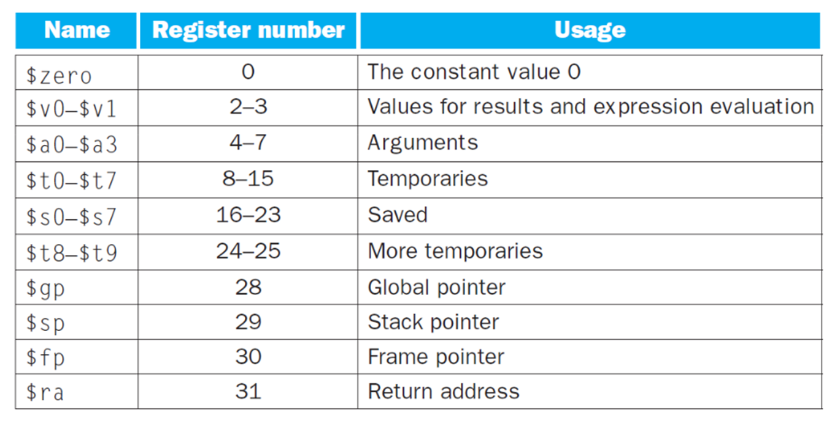
MIPS Registers
MIPS has 32 registers, numbered from 0 to 31, each with 32 bits. To identify a register in MIPS we thus need 5 bits (25=32).

Slide 4
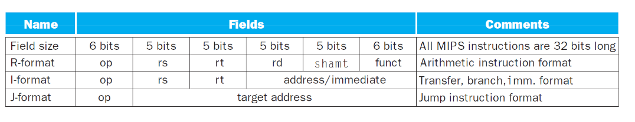
Register Type MIPS Instruction Format
MIPS instructions are encoded in binary, as 32-bit instruction words, called machine code. The layout of an instruction is called the instruction format. Only 3 different formats exist.

Slide 5
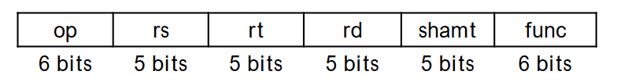
R type Format
MIPS fields have names to make them easier to discuss:
This format includes six different fields.
op is an operation code or opcode that selects a specific operation.
rs and rt are the first and second source registers.
rd is the destination register.
shamt is only used for shift instructions (0 not applicable).
func is used together with op to select an arithmetic instruction.

Slide 6
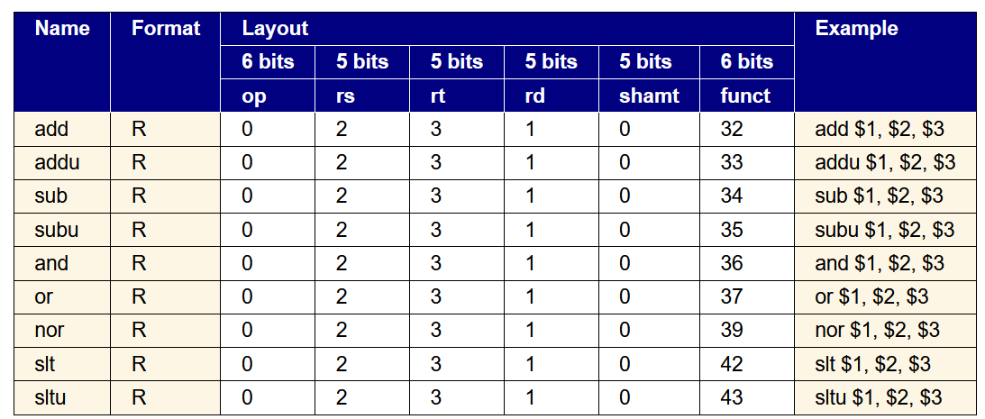
R type Format
funct: function code (identifies the specific R-format instruction) (6 bits)

Slide 7

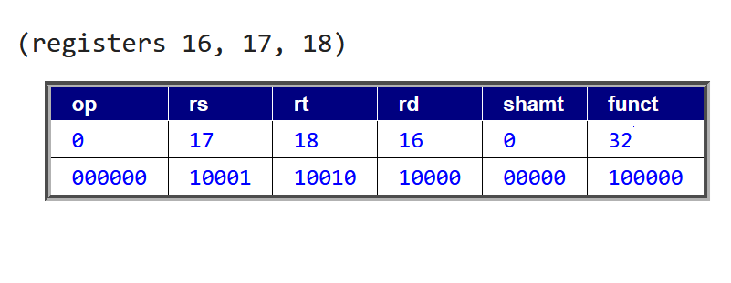
R type Format

Slide 8
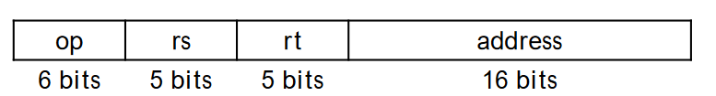
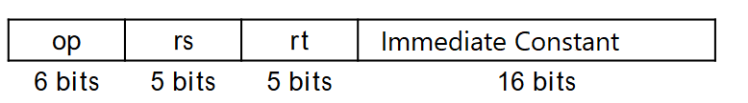
I type Format
Load, store, branch, and immediate instructions all use the I-type format.
For uniformity, op, rs and rt are in the same positions as in the R-format.

Slide 9
I type Format
Load, store, branch, and immediate instructions all use the I-type format.
For uniformity, op, rs and rt are in the same positions as in the R-format.
The meaning of the register fields depends on the exact instruction.
rs is an address register both for loads and stores, or an operand for conditional branch branch and.
rt is alsa an address register for both load s and srores stores, operand for conditional branch.

Slide 10
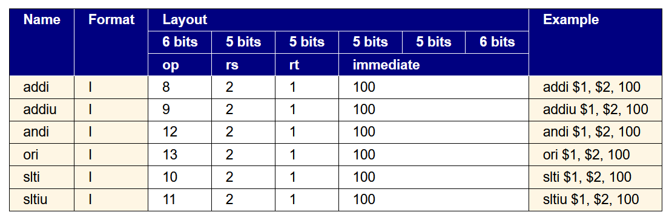
I type Format
Load, store, branch, and immediate instructions all use the I-type format.

Slide 11
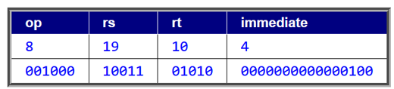
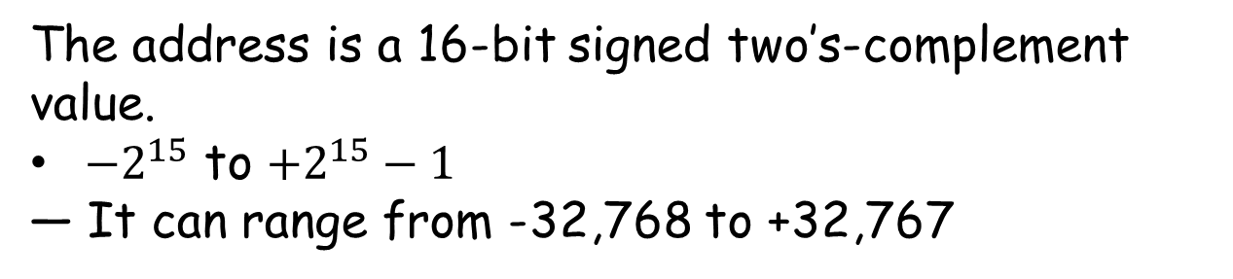
I type Format
Addi $t2, $s3, 4
Registers 10 and 19
The address is a 16-bit signed two’s-complement value.
${−2}^{15}$ to $+2^{15}−1$
— It can range from -32,768 to +32,767

Slide 12
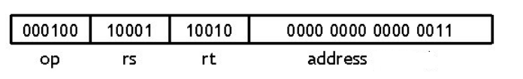
I type Format
beq $t0 $t1, label # if t0 = = t1, jump to “label”

Slide 13
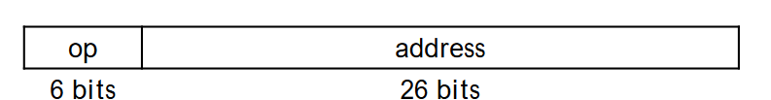
J type Format
Finally, the jump instruction uses the J-type instruction format
The jump instruction contains a word address, not an offset
— Remember that each MIPS instruction is one word long, and word addresses must be divisible by four.
— So instead of saying “jump to address 4000,” it’s enough to just say “jump to instruction 1000.”

Slide 14
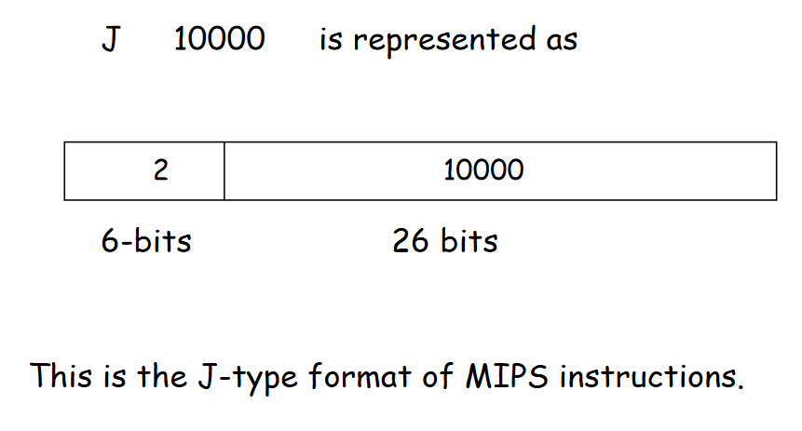
J type Format
For even longer jumps, the jump register, or jr, instruction can be used.
jr $ra # Jump to 32-bit address in register $ra

Slide 15
Register Addressing
In Register Addressing a source or destination operand is specified as content of one of the registers $0 - $31.
Register Addressing is considered the simplest addressing mode.
This is because both operands are in a register. Which allow instructions to be executed much more faster in comparison with other addressing modes because they does not involves with memory access.
The number of registers is limited since only a few bits are reserved to select a register.

Slide 16
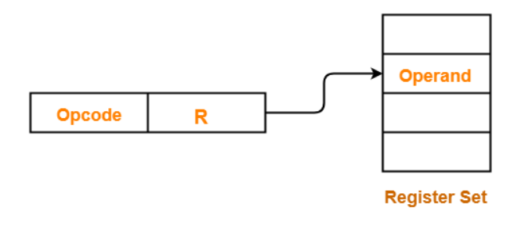
Register Addressing

Slide 17
Register Addressing
Consider the instruction: add $t0, $s1, $s2. Its decimal representation is:
op = 0 (arithmetic)
rs = 17 ($s1)
rt = 18 ($s2)
rd = 8 ($t0)
shamt = 0 (not used)
funct = 32 (add)
And the binary representation is:

Slide 18
Immediate Addressing
Immediate Addressing is a numeric value embedded in the instruction in the actual operand.
In immediate addressing , the operand is a constant within the encoded instruction.
Immediate addressing has the advantage of not requiring an extra memory access to fetch the operand , hence will be executed faster. However , the size of operand is limited to 16 bits (-32,768 to +32,767).

Slide 19

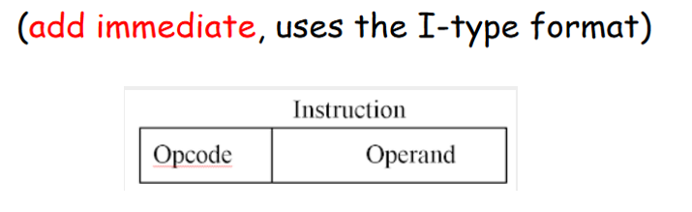
Immediate Addressing
Typically, the number will be stored in 2’s complement form; the leftmost bit of the operand field is used as a sign bit.
When the operand is loaded into a data register, the sign bit is extended to the left to the full data word size.
addi $s4, $t5, -73

Slide 20
Immediate Addressing
Some other Example of Immediate addressing are:
Immediate addressing use I type format.
16-bit immediate is used as an operand
ori $t3, $t7, 0×FF
Logically ORs the lower 16 bits of the contents of a general-purpose register with a 16-bit unsigned integer and stores the result in another general-purpose register.

Slide 21
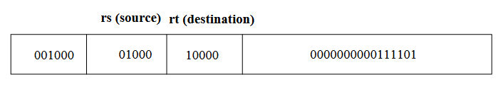
Immediate Addressing
addi $t0,$s0,61
Instructions are such that the constant can be directly added.
Since the operands in MIPS are 32 bits. So, the 16 bits are sign extended (not always).

Slide 22
Immediate Addressing
What is the MIPS assembly code to load this 32-bit constant into $s0?
0000 0000 0011 1101 0000 1001 0000 0000
lui $s0, $zero 61 #61 = 0000 0000 0011 1101
The content of $s0 is
0000 0000 0011 1101 0000 0000 0000 0000
ori $s0, $s0, 2304 #2304 = 0000 1001 0000 0000
The final value of $s0 is
0000 0000 0011 1101 0000 1001 0000 0000

Slide 23
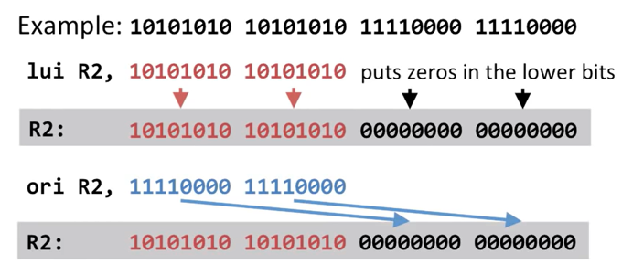
How do we load larger values?
Use two instructions to combine 16 bit immediates.
Load Upper Immediate (lui) Loads upper 16 bits
Or Immediate (ori) Loads lower 16 bits

Slide 24
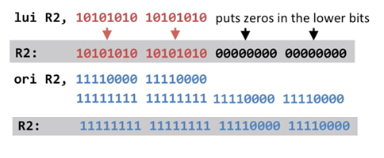
Is the immediate sign extended for ori instruction?
No, if it was sign extended we might end up with wrong value.
Logical operations don’t sign extended, only arithmetic ones.

Slide 25
Is the immediate sign extended for ori instruction?
Sign extending could put all 1s in the upper 16 bit ! This would change the upper 16 bit.

Slide 26
Is the immediate sign extended for ori instruction?
Why do we have both the “load upper immediate” and the “or bitwise immediate” instruction in order to load 32 bit constant.
The reason here is that lui loads the upper half and the ori loads the lower half.
So the two fit the instructions of the two halves of the 32 bit value.

Slide 27
Base Addressing or Indirect Addressing
The address of the memory is found by adding the base address (rs) to the sign-extended 16-bit offset (imm).
Base addressing is also known as indirect addressing , where a register act as a pointer to an operand located at the memory location

Slide 28
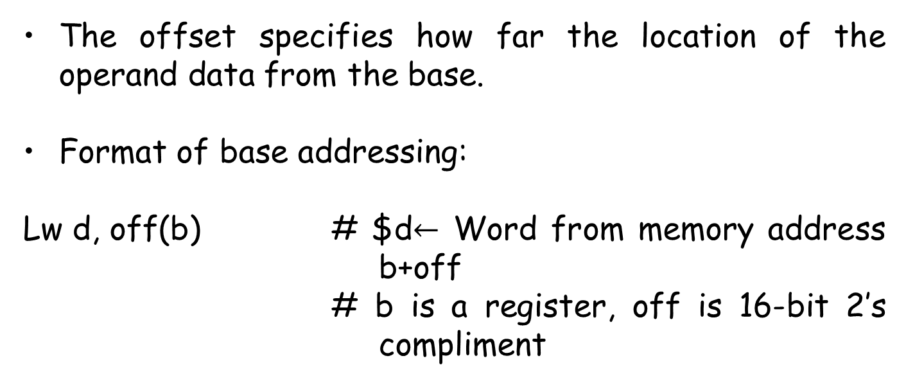
Base Addressing or Indirect Addressing
The offset specifies how far the location of the operand data from the base.
Format of base addressing:
Lw d, off(b) # $d$←$ Word from memory address b+off
# b is a register, off is 16-bit 2’s compliment

Slide 29
Base Addressing or Indirect Addressing
The address of the operand is the sum of the offset value and the base value (rs). However, the size of operand is limited to 16 bits because each MIPS instruction fits into a word.
The offset value is a signed number which is represented in a two's complement format. Therefore offset value can also be a negative value.

Slide 30
Base Addressing or Indirect Addressing
Here's an example for Base Addressing :
Instruction : lw $t1 , 4 ($t2)
where $t1 = rs
$t2 = register (base)
4 = offset value
Thus ; $t1 = Memory [$t2 +4]
In the example above , $t2 pointed to the base of a memory structure. The base is added to the offset (sign extended) 4 to find the actual address where the operand located and load the content of the memory location in register $t1.

Slide 31
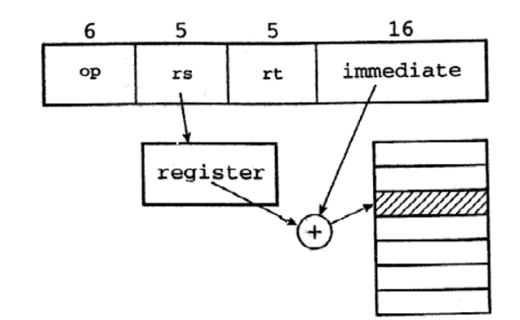
Base Addressing

Slide 32
Base Addressing
Some other example of Base addressing:
Base address+ sign-extended immediate
lw $s4 72($0) // address= $0 +72
Sw $t2 -25($t1) // address =$t1-25

Slide 33
PC-relative addressing
Conditional branch instruction use PC-relative addressing to specify the new address if the branch is taken.
A program counter (PC) is a CPU register in the computer processor which has the address of the next instruction to be executed from memory.
As each instruction gets fetched (reads from memory), the program counter increases its stored value by 1. After each instruction is fetched, the program counter points to the next instruction in the sequence. When the computer restarts or is reset, the program counter normally reverts to 0.

Slide 34
PC-relative addressing
In PC-relative addressing , the offset value can be an immediate value or an interpreted label value.
The effective address is the sum of the Program Counter and offset value in the instruction. The effective address determines the branch target.

Slide 35
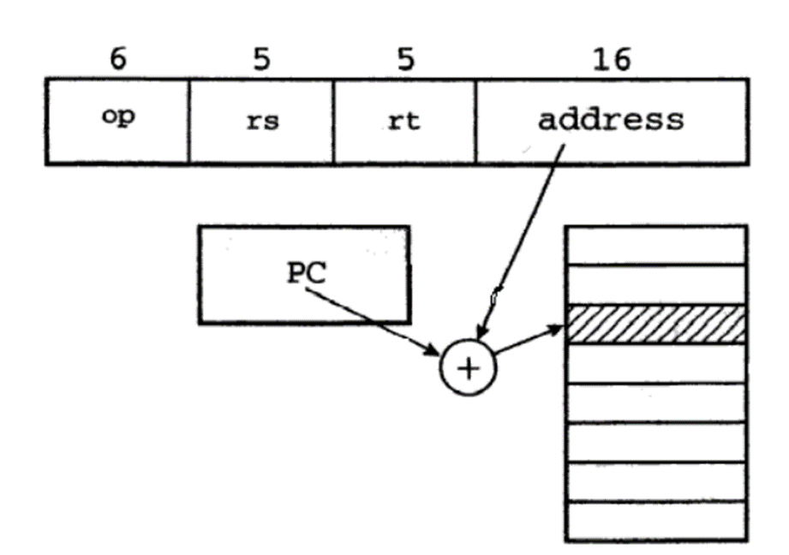
PC-relative addressing
It uses branching instructions, beq, bne
PC-relative | beq $s1, $s2, 200 | If ($s1==$s2) PC=PC+200×4
https://www.youtube.com/watch?v=nhbk6h56Omk
(Very Important)

Slide 36
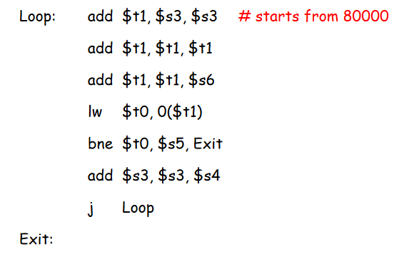
Revising machine Language in MIPS

Slide 37
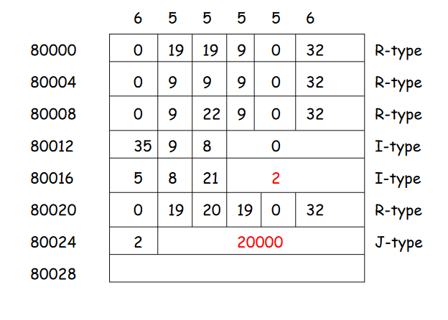
Revising machine Language in MIPS

Slide 38
Needs to know!
MIPS instructions classically take five steps:
Fetch instruction from memory.
Read registers while decoding the instruction. The regular format of MIPS instructions allows reading and decoding to occur simultaneously.
Execute the operation or calculate an address.
Write the result into a register.

Slide 39
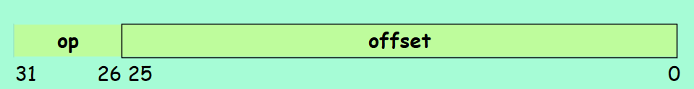
Pseudo-direct Addressing
In J type format, the J-type instruction encoding does not have enough bits to specify as full 32-bit jump address.
Opcode uses the 6-bits of the instructions
So, only 26-bits are left to encode the jump target instruction.

Slide 40
Pseudo-direct Addressing
In Pseudo-Direct addressing , the effective address is calculated by taking the upper 4 bits of the Program Counter(PC) (16 bit) , concatenated to the 26 bit immediate value , and the lower two bits are 00.
26 bits of the address is embedded as the immediate, and is used as the instruction offset within the current 256MB region defined by the MS 4 bits of the PC.
Pseudo direct addressing is not intended for relative jumps. It is an absolute jump.

Slide 41
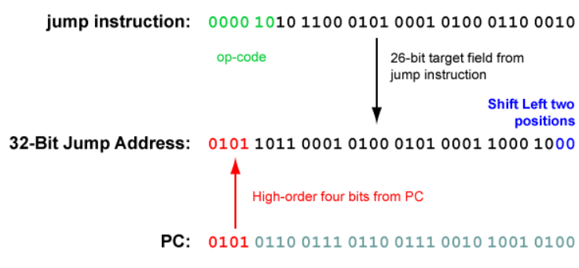
Pseudo-direct Addressing

Slide 42
Pseudo-direct Addressing
Why do we have 00 at the end of the immediate when we calculate the new instructions for jump instruction.
Instructions are word-aligned so their addresses always end in 00.
We always jump by a full instructions, which is 4 bytes, so we multiply offset by 4 by shifting it left two places.
https://www.youtube.com/watch?v=1bP6alXjDrw

Slide 43
Pseudo-direct Addressing
Therefore , the new effective address will always be a word-aligned and we can never have a target address of a jump instruction with the two bits anything other than 00.
The 26-bit target address field is transformed into a 32-bit address.
Address in Pseudo-Direct must be a multiple of four.

Slide 44
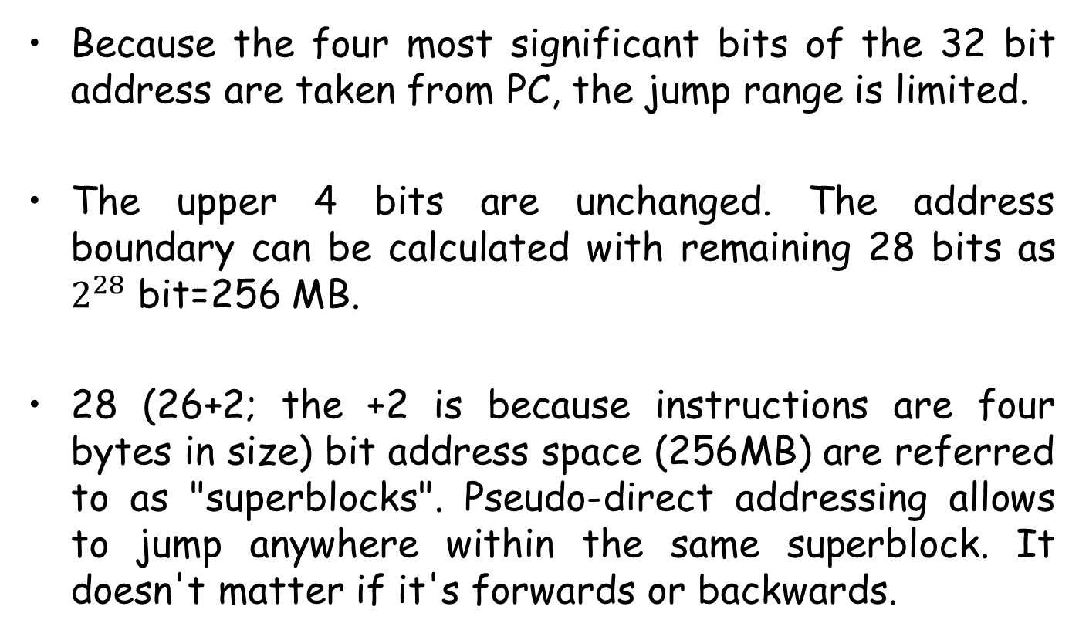
Pseudo-direct Addressing
Because the four most significant bits of the 32 bit address are taken from PC, the jump range is limited.
The upper 4 bits are unchanged. The address boundary can be calculated with remaining 28 bits as $2^{28}$ bit=256 MB.
28 (26+2; the +2 is because instructions are four bytes in size) bit address space (256MB) are referred to as "superblocks". Pseudo-direct addressing allows to jump anywhere within the same superblock. It doesn't matter if it's forwards or backwards.

Slide 45
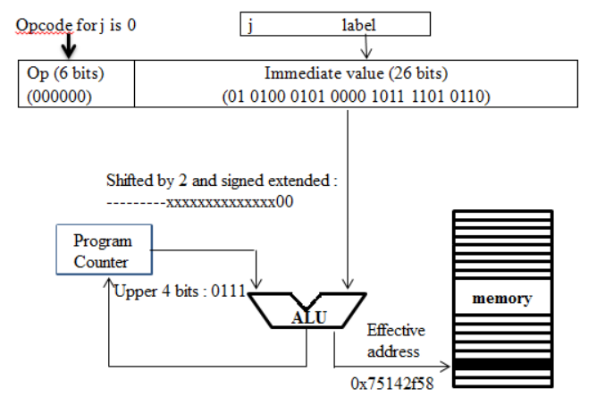
Implementation of Pseudo-direct Addressing

Slide 46
Addressing mode is not Instruction type
Addressing is how an instruction can access operands.It specifies how to compute the actual address(it can be constant value or address of memory or register)of the data needed. In basic format of instruction-
memory
register set
op | operand
operand
op | address
operand
op | Register name

Slide 47

Instruction Format is how you executes the program instruction.It helps the CPU to find out the which operation to be performed where is the data located and how to reach to the data.
*In Addressing mode we get actual data.In Instruction format we know how to get desired result or how to perform operation.
Addi $t1, $s3, 2
Register 10 and 12
op | Rs | Rt | immediate
8 | 12 | 10 | 2
001000 | 01100 | 01010 | 0000 0000 0000 0010

Slide 48
lw $t1,4($s1)
Register 8 and 19
op | rs | rt | offset
35 | 19 | 8 | 4
100011 | 10011 | 01000 | 0000 0000 0000 0010
Base addressing mode
*Both are I type instruction but different addressing mode

Slide 49
End

